Slide 1

Agentic AI Product Research & Purchase Decision System
Presented By:
B Vijaya Lakshmi

Slide 2
About Me
I am a postgraduate in Data Science from Bankatlal Badruka College for Information Technology, with a strong interest in Data Science, Machine Learning, Artificial Intelligence, and Generative AI.
I have hands-on experience with Python, SQL, Power BI, Machine Learning, Deep Learning, NLP, LLMs, RAG, LangChain, LangGraph, Agentic AI, MCP, and Prompt Engineering, along with data analysis and visualization.
I enjoy building AI-powered and data-driven solutions using modern technologies to solve real-world business problems, automate tasks, and generate meaningful insights.
LinkedIn: www.linkedin.com/in/bollapalli-vijaya-lakshmi
GitHub: Vijayalakshmibollapalli

Slide 3
Agenda
Introduction
Business Problem
Objective
System Workflow
Technology Stack
Model Deployment
Benefits
Future Scope
Challenges
Conclusion

Slide 4
Introduction
Online shoppers often need to check multiple websites before purchasing a product.
Product specifications, prices, reviews and alternatives are available across different sources.
Manually collecting and comparing this information is time-consuming.
This project uses Generative AI, LangGraph and MCP to automate the research process.
The system accepts a natural-language shopping request and generates a structured purchase recommendation.

Slide 5
Business Problem
Difficult to compare multiple products manually.
Product information is distributed across different sources.
Prices and availability can change frequently.
Reviews and product specifications require separate searches.
Users may spend significant time researching before making a purchase.

Slide 6
Objective
To develop an AI-powered shopping research and purchase decision system.
To understand shopping requests written in natural language.
To extract product type, budget, purpose, preferences, and important requirements.
To search for relevant products and specifications using MCP-based research tools.
To collect price information, product reviews, and comparison data.
To generate structured recommendations with relevant details, pros, cons, and alternatives.

Slide 7
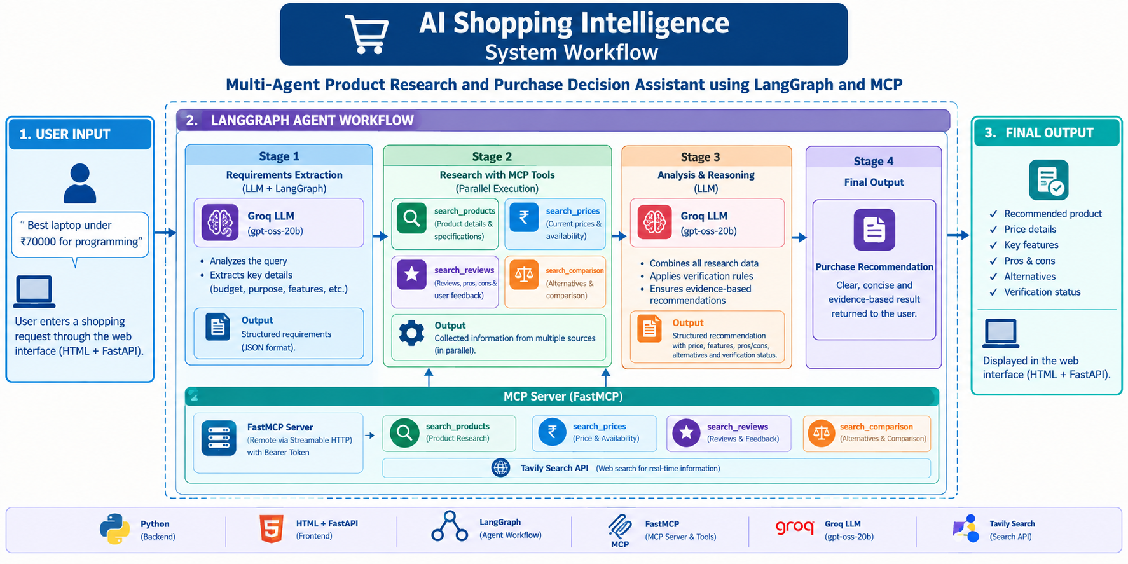

Slide 8
System Workflow
The user enters a natural-language shopping request through the FastAPI interface.
The system validates the request and sends it to the LangGraph workflow.
The Requirements Node extracts product type, budget, purpose, preferences, and other requirements.
The Research Node calls MCP tools to collect product specifications, prices, reviews, and comparison information.
The research tools use Tavily to retrieve relevant web search results.
The Recommendation Node sends the collected information to the Groq language model.
The LLM generates a structured recommendation based on the available evidence.
The final result is returned to the FastAPI interface and displayed to the user.

Slide 9
Technology Stack
Programming Language: Python - Used for developing the agent workflow, MCP server, and FastAPI application.
Frontend: Streamlit - Used to create the shopping request interface and display results.
Backend: FastAPI - Used to handle the web interface.
AI Model: Groq LLM - Used for requirements analysis and recommendation generation.
AI Workflow Framework: LangGraph - Used to manage the sequential workflow and shared state.
MCP Framework: FastMCP - Used to expose product research tools through a remote MCP server.
MCP Client: LangChain MCP Adapters - Used to connect the LangGraph application to the MCP tools.
Web Search: Tavily - Used to retrieve product, price, review, and comparison information.

Slide 10
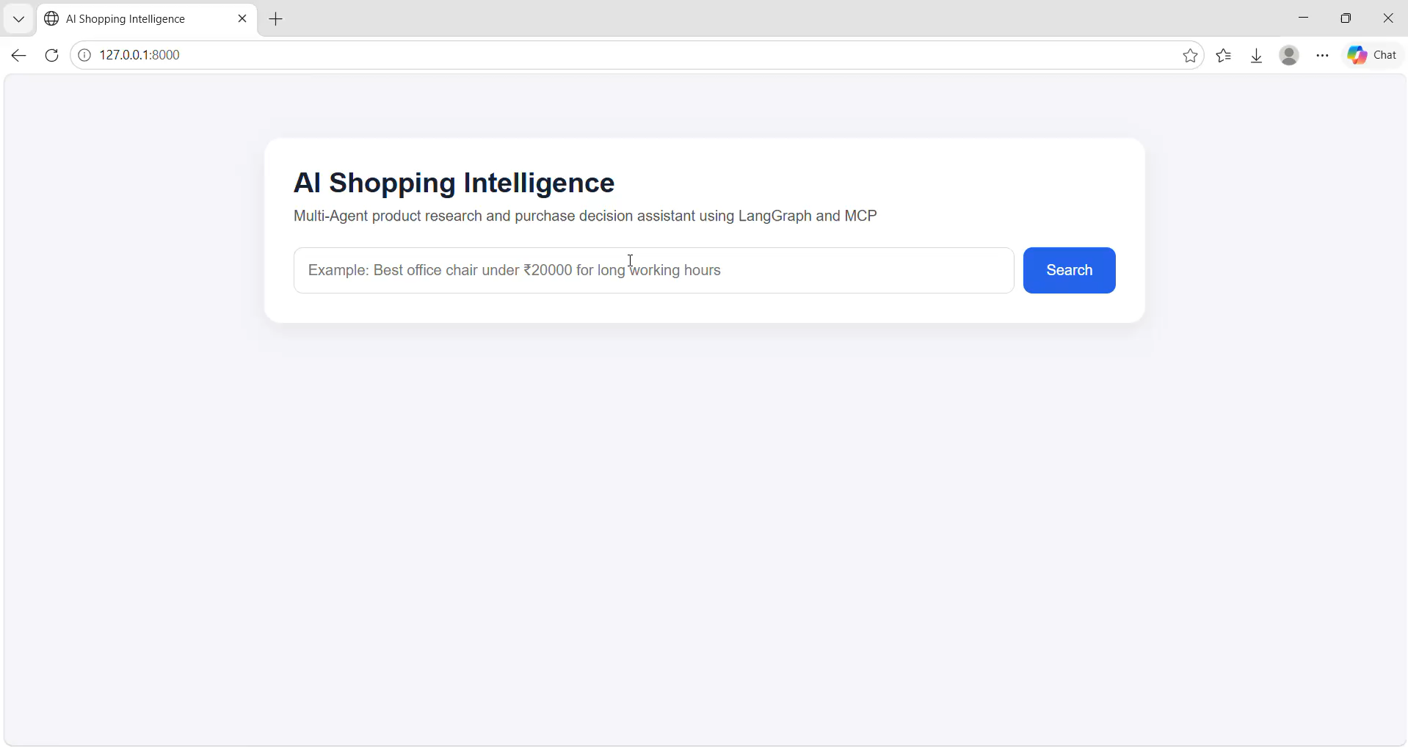
Deployment
For deployment Streamlit build a simple UI where users can input data and get predictions.

Slide 11
Benefits
Reduces the manual effort required for product research.
Automates the collection of product specifications, prices, reviews, and comparisons.
Supports structured comparison of products and alternatives.
Provides a consistent recommendation format with relevant details, pros, and cons.
Uses evidence-aware prompting to reduce unsupported product claims.
Provides a simple FastAPI interface for interacting with the AI shopping assistant.

Slide 12
Challenges Faced
Challenge | Solution
Understanding user shopping requirements | LangGraph + Groq extracts budget, purpose and product requirements.
Collecting product, price and review information | FastMCP provides separate research tools.
Slow sequential research | asyncio.gather() performs MCP searches in parallel.
Preventing unsupported recommendations | Evidence-based prompting and verification rules.
Managing retrieved information and user interaction | Content trimming + FastAPI/HTML interface.

Slide 13
Future Scope
Integrate structured product databases and retailer APIs for more reliable product information.
Add real-time price tracking and price-drop notifications.
Add stronger source citation and evidence verification for each recommendation.
Introduce personalized recommendations based on user preferences and purchase history.
Add support for image-based product search and visual comparison.
Deploy the system on cloud infrastructure for scalable usage.

Slide 14
Conclusion
The project provides an AI-powered approach to product research and purchase decision support.
It combines LangGraph workflow orchestration with MCP-based research tools.
The system extracts user requirements and collects product, price, review, and comparison information.
FastAPI provides a simple interface for users to submit shopping requests and view results.
Evidence-aware prompting helps the system handle missing and unsupported information.
The project demonstrates the integration of LLMs, tool calling, workflow orchestration, and web research.

Slide 15

THANK YOU

